Slide 1











YouTube Songs
Analysis
Power BI Dashboard
By: Casmir Orori

Slide 2
Problem Statement
This internship project aims to conduct a comprehensive analysis of YouTube songs data using Power BI.The dataset contains key attributes such as video ID, channel title, title, description, tags, published date,view count, like count, favorite count, comment count, video duration, video definition, and caption
details.
The goal is to utilize Power BI to create insightful visualizations and reports that provide a deeper understanding of YouTube songs' performance, popularity, and user engagement. The analysis aims touncover trends, preferences, and patterns in the data to aid content creators and stakeholders in optimizing their YouTube song content.

Slide 3
Project Objectives
Data Cleaning and Preparation
Exploratory Data Analysis (EDA)
Content and Channel Analysis
Temporal Trends
User Engagement Insights

Slide 4
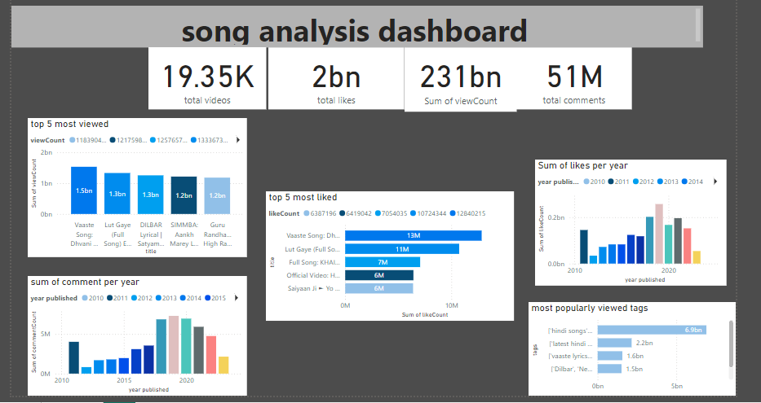

Slide 5
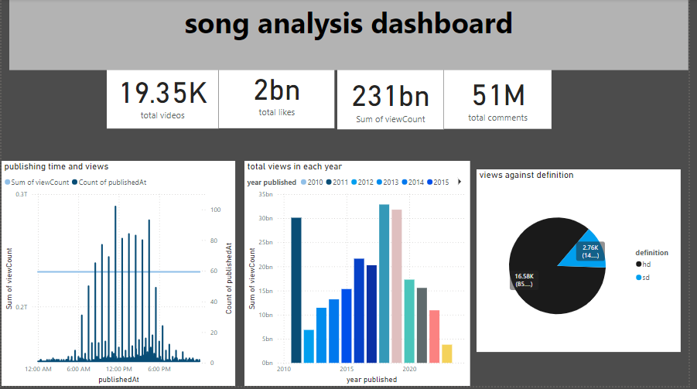

Slide 6
Recommendations
Use relevant tags for search visbility
Promote videos on social media
Collaborate with other content creators
Encourage subscriptions for updates

Slide 7


